Slide 1
Inter-VLAN Routing & DHCP
Course Code: CSC 3116
Course Title: Computer Networks
Dept. of Computer Science
Faculty of Science and Technology
Lecturer No: | Lab 10 | Week No: | 10 | Semester: | Summer 19-20
Lecturer: | Md. Sakir Hossain, Email: sakir.Hossain@aiub.edu

Slide 2
Lecture Outline
Inter-VLAN Routing
DHCP configuration

Slide 3
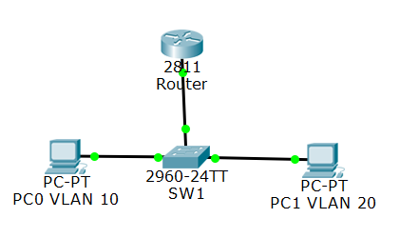
Inter-VLAN Routing
How can we enable PC0 of VLAN 10 to
communicate PC1 of VLAN 20?
Using Router
Multiple access line between R1 and SW1;
one for each VLAN
2. One trunk interface between SW1 and R1, with
multiple subinterfaces. ROAS technique
3. Using Layer 3 switch with switch virtual interface

Slide 4
Inter-VLAN Routing….
Configure the switch to create VLANs & interfaces
to each VLAN
Configure Fa0/3 interface of the switch as a trunk
Switchport(config)#interface fa0/3
Switch(config-if)#switchport mode trunk
Configure the Router
Select the Fa0/0 interface of the router
interface fa0/0
Activate the interface
no shutdown
Create a virtual subinterface
interface fa0/0.10
Fa0/0
Fa0/3

Slide 5
Inter-VLAN Routing….
Specify the trunking protocol & VLAN
encapsulation dot1q 10
Assign an IP address to the subinterface (default gateway of the VLAN)
ip address 192.168.10.254 255.255.255.0
Create another virtual subinterface for VLAN 20
interface fa0/0.20
Specify the trunking protocol & VLAN
encapsulation dot1q 20
Assign an IP address to the subinterface
(default gateway of the VLAN)
ip address 192.168.20.254 255.255.255.0
Fa0/0
Fa0/3

Slide 6
DHCP
DHCP server
Router
Computer
DHCP server configuration:
Scenario I: DHCP server located in LAN
Scenario II: DHCP server located in different network

Slide 7
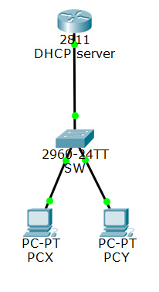
DHCP….
Scenario I: DHCP server located in LAN
Configure the interface by which DHCP server is connected
to the LAN
int fa0/0
ip address 192.168.1.254 255.255.255.0
Create a DHCP pool and give its name
ip dhcp pool mypool
Define the network IP address so that IP address from that
block can be allocated
network 192.168.1.0 255.255.255.0
Define the DNS server’s IP address (optional)
dns-server 172.168.1.150
5. Define the default gateway (optional)
default-router 192.168.1.1
6. Specify the range of address not to be leased out to the client (optional)
ip dhcp excluded-address 192.168.1.1 192.168.1.10
Fa0/0
Fa0/0
Network: 192.168.1.0
Mask: 255.255.255.0

Slide 8
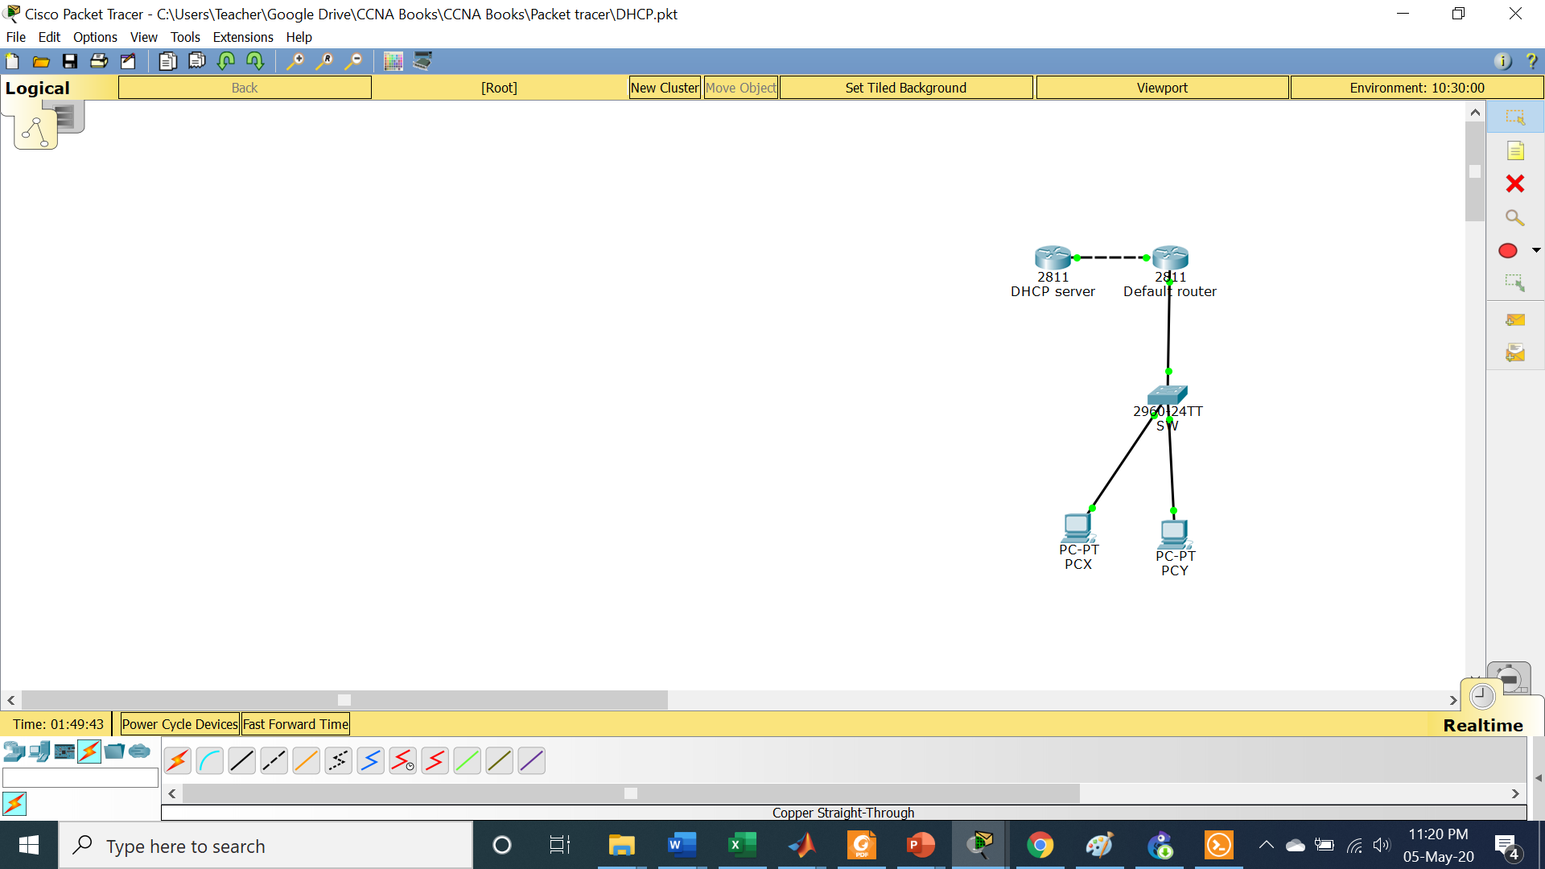
DHCP….
DHCP server is in different network.
172.16.1.0/24
.
Fa0/1
Fa0/0
Fa0/0
Configure the DHCP server as before
ip dhcp pool mypool
network 192.168.1.0 255.255.255.0
dns-server 192.16.1.150 (suppose)
default-router 192.168.1.254
ip dhcp excluded-address 192.168.1.1 192.168.1.10
192.168.1.0/24

Slide 9
DHCP….
DHCP server is in different network….
172.16.1.0/30
Fa0/1
Configure the interfaces of the DHCP server and
default router
Configure the Fa0/0 interface of the default router with
interface fa0/0
ip address 192.168.1.254 255.255.255.0
no shutdown
Fa0/0
Fa0/0
Configure each router to perform routing using any protocol, RIPv2 or EIGRP or OSPF
192.168.1.0/24

Slide 10
DHCP….
DHCP server is in different network….
172.16.1.0/24
Fa0/1
What will happen if PCX sends s DCHP broadcast
to 255.255.255.255 address?
Fa0/0
Fa0/0
It will be blocked by the default router.
Why?
Router divide the broadcast domain.
192.168.1.0/24

Slide 11
DHCP….
DHCP server is in different network….
172.16.1.0/24
How can the PCX be enabled to reach to DHCP server?
Fa0/1
Fa0/0
Fa0/0
172.16.1.2
In addition to the configuration of Fa0/0 interface of
the default router (as done before), configure this interface
with the helper-address
interface fa0/0
ip helper-address 172.16.1.2
Address of the DHCP server
192.168.1.0/24

Slide 12
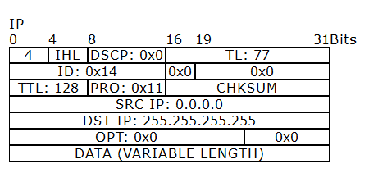
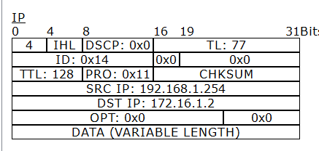
DHCP….
DHCP server is in different network….
Incoming PDU at default router from PCX
Outgoing PDU from default router to DHCP

Slide 13
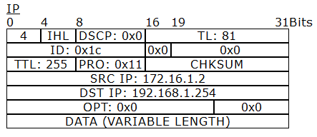
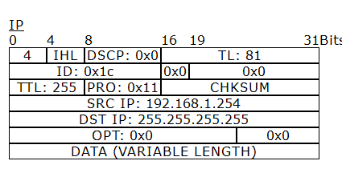
DHCP….
DHCP server is in different network….
Incoming PDU at default router from DHCP
Outgoing PDU from default router to PCX

Slide 14
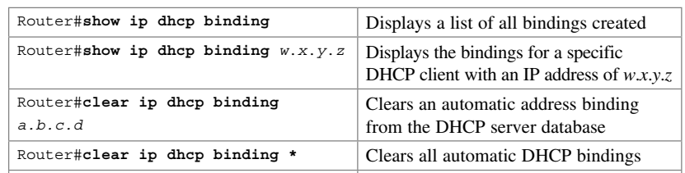
DHCP….
Verifying configuration

Slide 15
References
[1] S. Empson, CCNA Portable Command Guide, 2nd ed., Cisco Systems, Inc., 2008, USA.

Slide 16
Recommended Books
Official Cert Guide CCNA 200-301 , vol. 1, W. Odom, Cisco Press, First Edition, 2019, USA.
CCNA Routing and Switching, T. Lammle, John Wily & Sons, Second Edition, 2016, USA.

